Slide 1
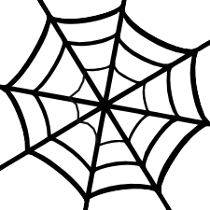
RESEARCH WEBS
FAMOUS DESIGNERS
USING TECHNOLOGYSTUDENT.COM TO FIND INFORMATION
To help you ﬁnd the information you need, use the ‘search’ function at the bottom of any page of technologystudent.com. The majority of the answers will be found on this website.
For any other information, use a search engine such as Google.
HELPFUL TIP
When using the search function, at the bottom of each page of technologystudent.com, select this option.
WORLD ASSOCIATION OF TECHNOLOGY TEACHERS
https://www.facebook.com/groups/254963448192823/
www.technologystudent.com © 2020 V.Ryan © 2020

Slide 2
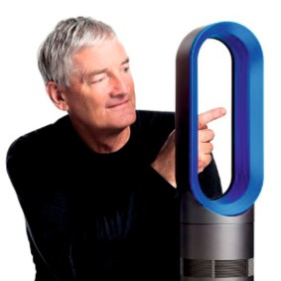
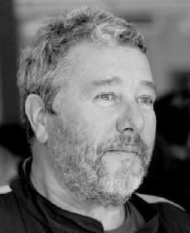
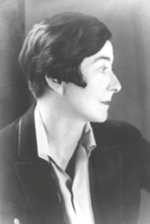
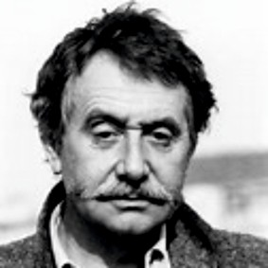
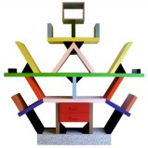
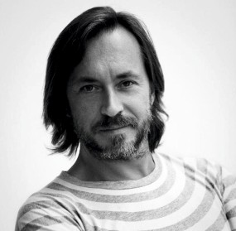
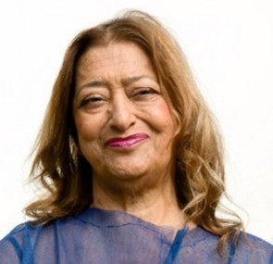
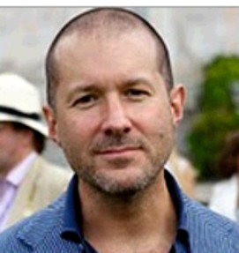
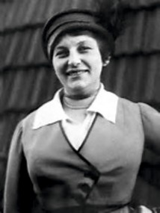
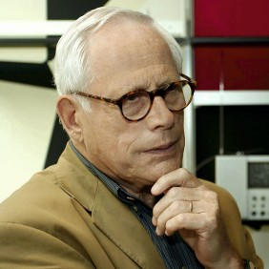
REVISION WEB - FAMOUS DESIGNERS
JAMES DYSON
PHILIPPE STARCK
WORLD ASSOCIATION OF TECHNOLOGY TEACHERS https://www.facebook.com/groups/254963448192823/
www.technologystudent.com © 2017 V.Ryan © 2017
RESEARCH EACH OF THE DESIGNERS. WRITE KEY FACTS ABOUT EACH DESIGNER, ON THE
REVISION WEB. ADD A SMALL IMAGE(S), SUCH AS A SAMPLE OF ONE OF THEIR DESIGNS. AN EXAMPLE HAS BEEN COMPLETED FOR YOU.
EILEEN GRAY
1917 - 2007
Italian architect and designer
ETTORE SOTTSASS
Carlton Dresser
Ettore Sottsass' designs
are unique.
1981-formed the
Memphis Group
Known for using color,
shape, unconventional
materials.
MARC NEWSON
ZAHA HADID
JONATHAN IVE
LILLY REICH
DIETER RAMS

Slide 3
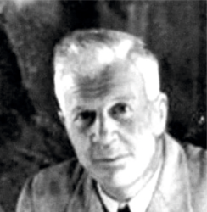
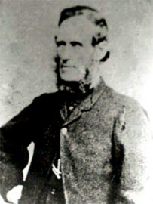
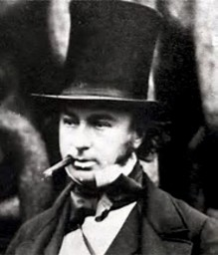
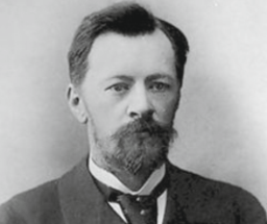
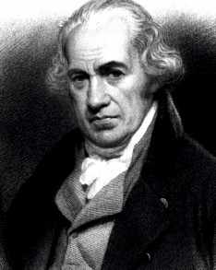
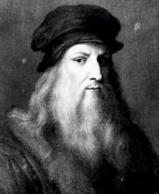
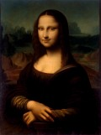
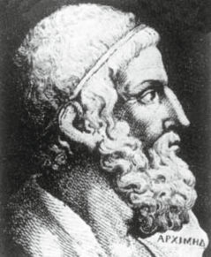
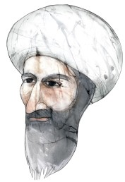
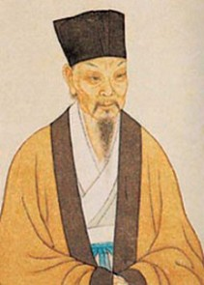
REVISION WEB - FAMOUS DESIGNERS
BARNES WALLIS
KIRKPATRICK MACMILLAN
WORLD ASSOCIATION OF TECHNOLOGY TEACHERS https://www.facebook.com/groups/254963448192823/
www.technologystudent.com © 2017 V.Ryan © 2017
RESEARCH EACH OF THE DESIGNERS / ENGINEERS. WRITE KEY FACTS ABOUT EACH DESIGNER,
ON THE REVISION WEB. ADD A SMALL IMAGE(S), SUCH AS A SAMPLE OF ONE OF THEIR DESIGNS. AN EXAMPLE HAS BEEN COMPLETED FOR YOU.
ISAMBARD KINGDOM BRUNEL
VLADIMIR SHUKHOV
Flying machines
One of the greatest painters of all time
geometry and science
sculpture, engineering, cartography,
1452 - 1519 AD (ITALY)
JAMES WATT
Mona Lisa
ARCHIMEDES
Alī Ibn Khalaf al-Murādī
Su Song
Leonardo Da Vinci

